Slide 1
HTML5 accessibility
is it ready yet?
Steve Faulkner & Hans Hillen
The Paciello Group (TPG)

Slide 2
HTML5 process
W3WHATWGC
W3C
WHATWG
Notes:
The current HTML5 development process is a hybrid of the W3C and WHAT WG development processes. There are people who prefer one process over the other, but the mixture of these processes makes for better specification outcomes.

Slide 3
and then there’s the rest who
probably don’t care
photo by Joel bez
Notes:
Most people who are intersted and excited by HTML5 are not intersted in the politics behind its development.

Slide 4
“accessibility
is about more than
screen readers...”
Notes:
Accessibility covers a range of issues for people with varying impairments including vision, mobility, cognitive and aging.

Slide 5
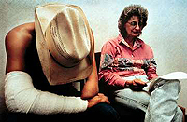
...but in this session we are talking about assistive technology support, if you are expecting more you will be disappointed
Notes:
The implementation of new HTML5 element features in browsers affects in particular users who rely assistive technology, such as screen readers, to access web content.

Slide 6
Accessibility APIs
MSAA
Iaccessible2
UI automation
AX
STK
roles
states
properties
interaction
+ device independent
interaction
Notes:
For users of assitive technology to be able to access and interact with web content, browser developers need to expose HTML5 features through accessibility applications interfaces and make interactive features operable without the use of a mouse.

Slide 7
Accessibility API
Input device
browser
role=button
state=focused
value=submit query
action=press
Notes:
Each HTML feature has a role, name, state and other property values that need to be hooked into the accessibility APIs by the browser. Assistive technology can then use this information to convey a representation of the feature to users.

Slide 8
so, is it ready yet?
HTML5 accessibility
that is????

Slide 9
short answer:
NO!
Notes:
HTML5 features are currently either not implemented or not implemented with accessibility support.

Slide 10
long answer is:
NOT BY A
LONG SHOT
Notes:
There is still much work to be done by browser vendors to include accessibility support in their products.

Slide 11
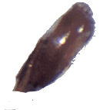
NIT BY A LING SHIT
LING
(HTML5)
<------ NIT (accessibility)
Notes:
Without accessibility support HTML5 is like a fairly ordinary fish with a parisite close by.

Slide 12
Accessible HTML5
will be a beautiful thing
Notes:
With accessibility support HTML5 will become a powerful, useful, interoperable, versatile language for the world widw web.

Slide 13
HTML5 is
a work
in progress

Slide 14
form controls
structures
canvas
video
audio
ARIA
‘fallback’
‘text alternatives’
Notes:
The devlopment of the W3C HTML5 specification and its implementation is a work in progress. While the specification is at an advanced stage of development, there are still issues to be worked out and much implementation work to be done.

Slide 15
w h o a r e t h e h e r o e s ?
Notes:
Which browsers provide good accessibility support for HTML content? In other words which browsers can be used by people with screen readers to surf the web? On Windows Firefox and Internet Explorer. On Mac only Safari.

Slide 16
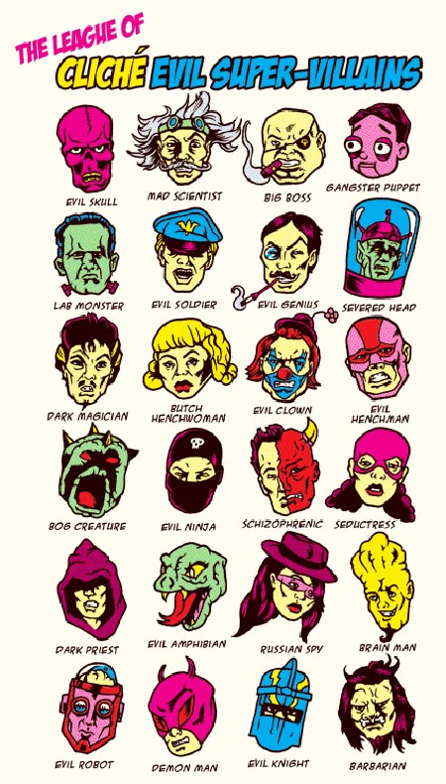
who are
the villains?
Notes:
There are not really any villians; Google chrome is not yet accessible on any platform, but they are working hard on providing accessibility support. Firefox works great on windows and linux, but not on Mac OSX, Safari works well on Mac OSX and iOS 4 but not on Windows. Opera does not have accessibility support on any platform, but provides features that other browser do not, which are useful to a range of people with disabilities who do not use assitive technology. It is also rumoured that Opera are working on AT support, but that has been a rumour for years...

Slide 17
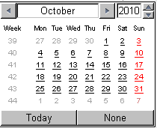
?
?
when will browsers
implement HTML5 UI features in a way that developers will want to use them?
when will browsers
expose HTML5 features via accessibility APIs
when will browsers
implement HTML5 UI features?
?
?
?
Notes:
One question is, when will browser vendors implement the HTML5 interface elements? Another is when will they implement accessibility support? And yet another is When will they implement in particluar the new HTMl5 form controls in a way that developers want to use them and are able to style them as desired.

Slide 18
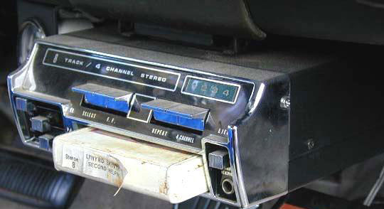
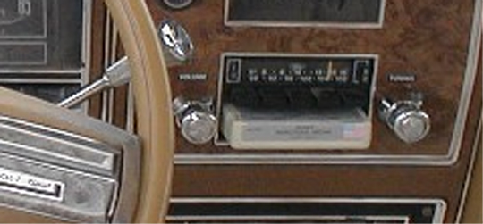
bolt-on
VS
built-in

Slide 19
a tale of 2 browsers
Notes:
3 tweets about Opera mini on the iPhone:
I tweeted about my like of Opera mini: “I find Opera mini the best browser for viewing/reading web pages on iPhone.”
@mishu70 asks: “@stevefaulkner is it accessible with VO?”
@ppatel replies: “@mishu70 No. Oper mini is most certainly not accessible to VoiceOver.”

Slide 20
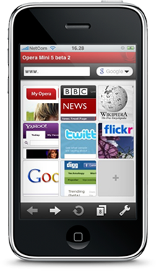
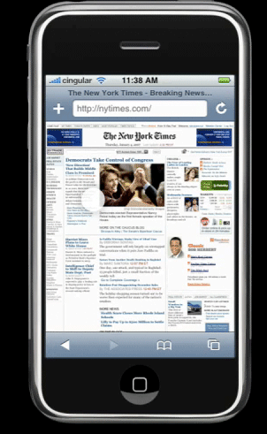
a tale of 2 browsers
Opera mini
Safari
Using VoiceOver
Notes:
When using VoiceOver, Opera mini is akin to a black screen as it is unsuable. The opera developers have not bolted on the accessibility support in Opera mini.

Slide 21
accessibility is always
bolted on,
sometimes by
more
Browsers
ATs
CMS/tool developers
library developers
web developers
users
less
Notes:
Generally more accessibility is bolted on by browser vendors than by other participants in the process.

Slide 22
generally speaking, the earlier it is bolted on, the more robust
more
Browsers
ATs
CMS/tool developers
library developers
web developers
users
less
Notes:
Generally, the earlier accessibility is bolted on the more robust it is.

Slide 23
but if it’s done right
it makes no difference
to the end user...

Slide 24
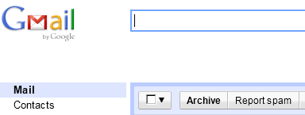
<DIV class="J-K-I J-J5-Ji J-K-I-Js-Zq J-K-I-Js-Zj J-K-I-JW" role=button tabIndex=0
unselectable="on" act="9" closure_uid_1bjdqs="1012"><DIV class="J-J5-Ji J-K-I-Kv-H" unselectable="on">
<DIV class="J-J5-Ji J-K-I-J6-H" unselectable="on">
<DIV class=J-K-I-KC unselectable="on">
<DIV class=J-K-I-K9-KP unselectable="on">&nbsp;</DIV>
<DIV class=J-K-I-Jz unselectable="on">Report spam</DIV> </DIV></DIV></DIV></DIV>
...and no matter what is bolted on by the browser, developers will find a reason to want something else

Slide 25
which is why WAI-ARIA is needed
preaching abstinence does not work
accessibility = the art of the killjoy
accessibility = the art of creative inclusivity
Notes:
ARIA is the Web Accessibility Initiative Accessible Rich Internet Applications specification.

Slide 26
canvas
focus ring - rough consensus
navigable sub-DOM - rough consensus + running code
caret – no consenus
image map – rough consensus

Slide 27
canvas example

Slide 28
HTML5accessibility.com
Notes:
This site is a resource to provide information about which HTML5 user interface features are accessibility supported in browsers, making them usable by people who rely upon assistive technology (AT) to use the web.
It is not intended to dissuade developers from using HTML5 features. Sometimes there are better choices, sometimes developers have to add a little extra to make the feature useful or usable, and other times features have simply not been implementedby any browser or only by browsers that do not yet support assistive technologies. As a consequence it may not yet be practical to use a particular HTML5 feature. Example work arounds for lack of implemenation or lack of accessible implemention are linked from the Solutions page.

